Slide 1



DUBAI AUTODROME
KARTING ACADEMY
Parent Information Pack
TERM 1 - 2025
SEP - NOV 2025
www.dubaiautodrome.ae

Slide 2

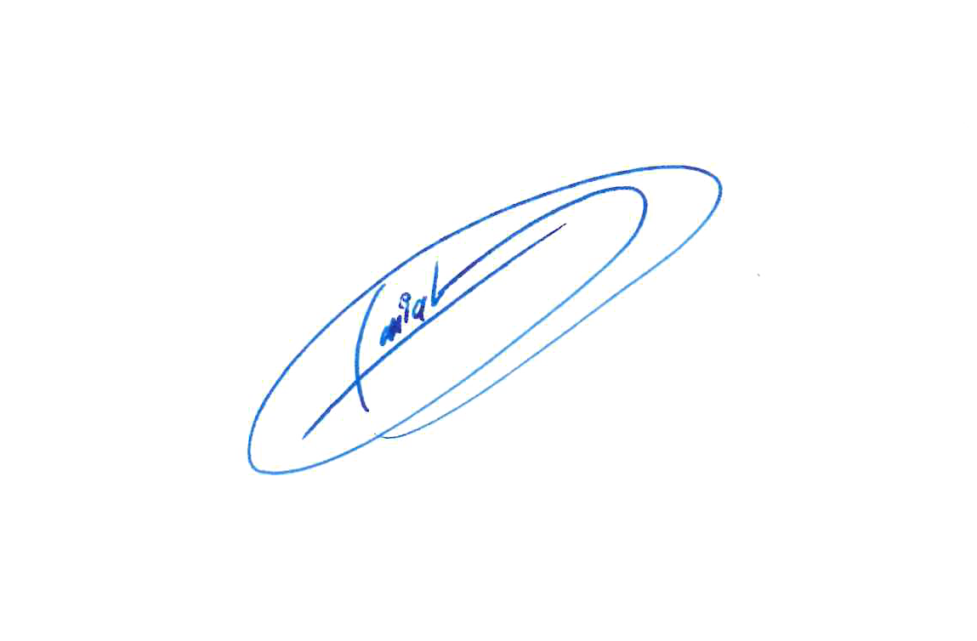
Dear Parents,
On behalf of Dubai Autodrome, we are delighted to announce the dates for the new school term.
At DAKA, your child will be immersed in the most adrenaline fueled after-school programme in the UAE. I do wish they had such a program in my day!
Please remember that motorsport is challenging – it will be hot at times and physically demanding. We encourage our students to drink plenty of water before and during their DAKA classes.
Breaks are encouraged too, where students can take a rest from the driving sessions whenever they feel the need to. As we know, everyone progresses at their own pace!
At the end of the course, your child will understand the different parts of a go-kart and how to maintain them. He or she will also learn the correct racing line, overtaking techniques and all the rules and regulations of motorsport.
We look forward to welcoming your son/daughter into the world of motorsport.
Yours Sincerely,
Faisal Al Sahlawi
General Manager

Slide 3
Dates & Timings
Our next term commences on Monday 8th September 2025 for all 3 DAKA levels.
Level 1 – Thursdays (Starting 11th Sep) - Indoor Kartdrome
Level 1 – Wednesdays (Starting 10th Sep) - Indoor Kartdrome
Level 2 – Tuesdays (Starting 9th^{th} Sep)– Outdoor Kartdrome
Level 3 – Mondays (Starting 8th Sep) – Outdoor Kartdrome
Level 1 is open to beginners and experienced drivers above the age of 7 years (on or before 10th September 2025)
Level 2 is open to racers with more experience:
Graduates of DAKA Level 1.
Fast-track is only allowed with approval of DAKA Coordinator.
Children who have visited the Indoor Kartdrome 15 times or more and accumulated more than 150 laps with lap times under 33 seconds may be considered.
Members of the Sodi World Series championship.
Children who are 15 years or older are recommended to start with level two.
Level 3 is open to graduates of Level Two.
This is where all the skills students have acquired through levels one and two get put to the test through a mix of lessons and SWS race nights.
They will also be given the opportunity to delve deeper into kart maintenance and have hands-on experience working with two-stroke race karts.
Students will also be equipped with the necessary knowledge to pass the race license assessment.

Slide 4



Course Outline
Our DAKA programme consists of various driving and mechanical theory and practical sessions which when combined help our students develop the skills necessary to become a racing driver. The programme covers:
Rules and guidelines on how to drive safely and stay safe in a kart.
Structured racing tuition with our experts resulting in reducing lap times.
Driving sessions on different track combinations to master different racing lines. These are changed over the period of the programme and become progressively more difficult.
Workshop classes covering various mechanical tasks such as, wheel removal/refitting, engine oil change and engine removal. These also progress to more difficult tasks as the course progresses.
DAKA classes are structured as follows:
Up to 3 x 15-minute karting sessions
30-minute practical in the workshop
Level 3:
Race nights – Rookie Junior/Senior races
Lesson nights – Open practice 45-60 minutes
+ 30 minutes of practical.

Slide 5
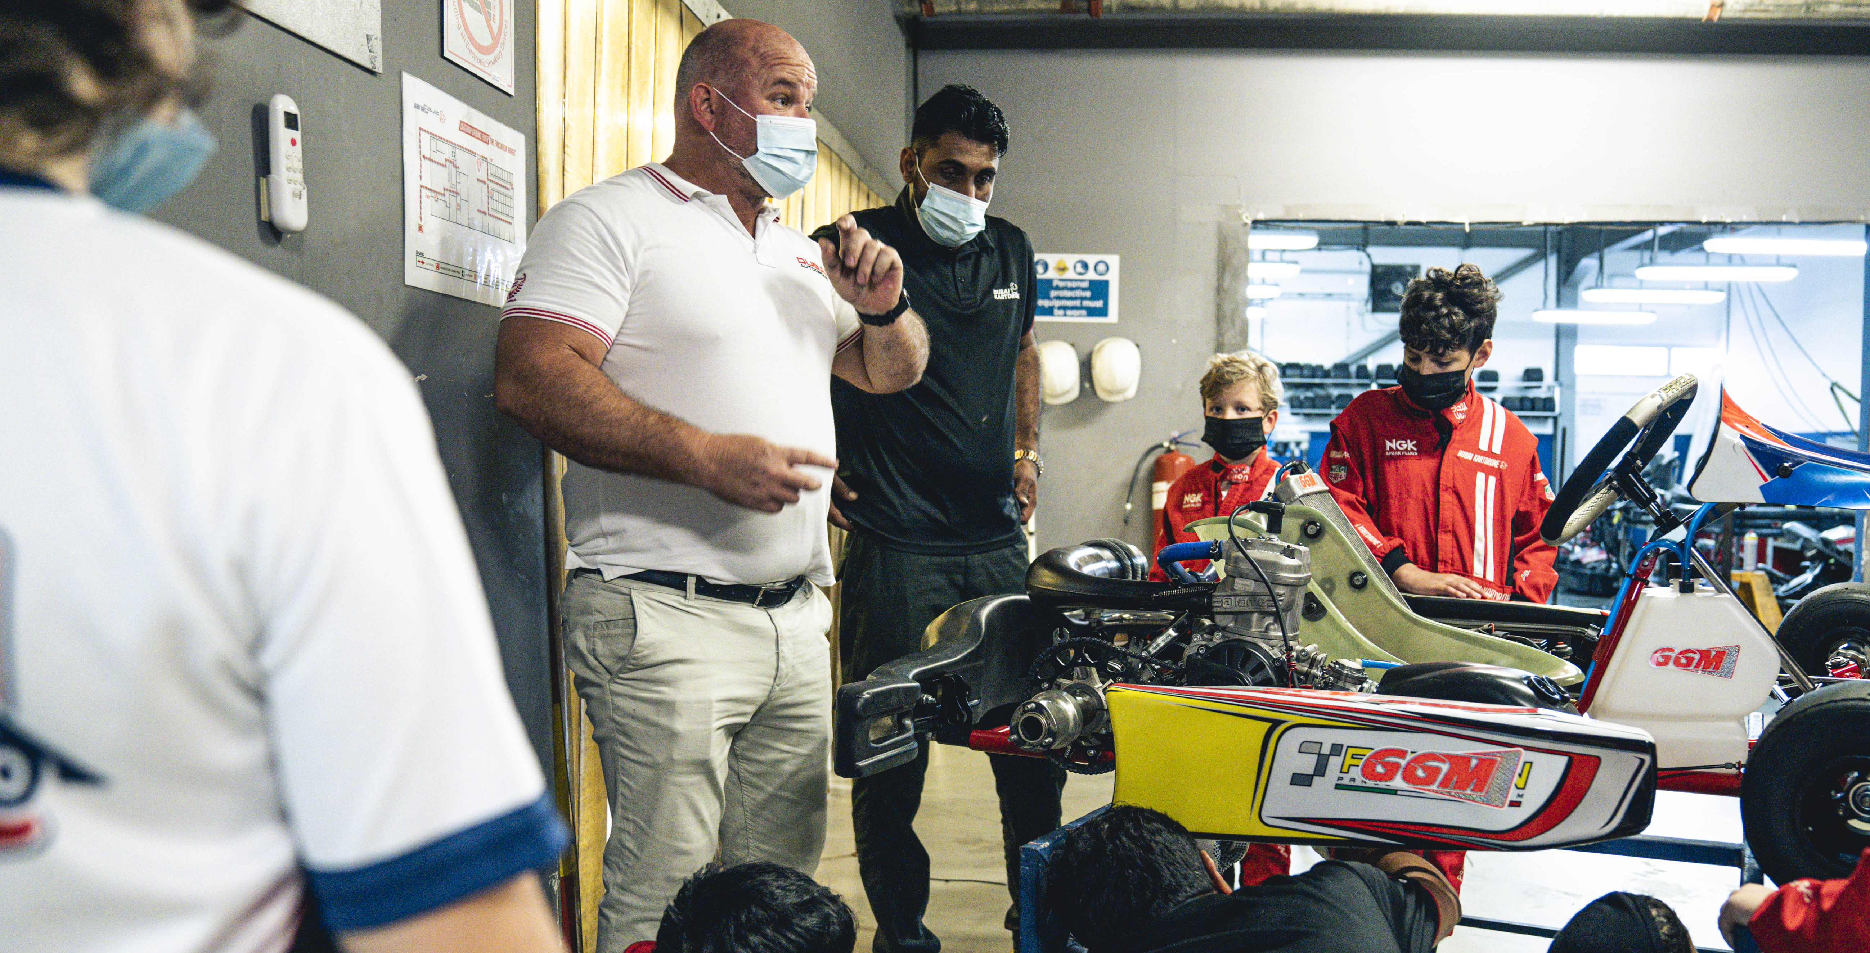
Course Outline
Over a period of 9 months, our students are able to progress through all 3 different levels of the academy. The academy will help students develop the necessary skills to become racing drivers but also equip them with valuable knowledge and build confidence that they can apply to other disciplines.
The programme is developed and overseen by experienced and multiple championship winning drivers and coaches providing the highest standard of kart training to children in the UAE. DAKA provides a pathway to a professional career in motorsport and acts as a natural first-step into series such as the Emirates School Karting Series (ESKC), Sodi World Series (SWS) and the world-renowned Dubai Kartdrome Endurance Series.

Slide 6
Curriculum
DAKA will work through set levels of tuition as follows:
Levels | Track Exposure | Curriculum Overview
One | Indoor Clockwise & Anti-Clockwise with One sessions at Outdoor Kartdrome (Cadet layout) | Introduction to karting: learn the basics of kart driving. DAKA will run both clockwise and anti-clockwise track configurations to allow drivers to adapt and learn the following: Correct driving positions. Racing lines; understanding corner apexes & braking points. Direction and specifics of each configuration. Memorization of different configurations.
Two | Outdoor Kartdrome (Cadet, National and International courses) | More comprehensive driving and mechanical classes, introduction to race craft where drivers will start to develop skills and an understanding of the following: Overtaking. Defending their position, whilst optimizing consistency and smoothness on track. The karting coaches will develop race discipline by encouraging drivers only to overtake through certain corners, helping them gain confidence and master overtaking techniques. An introduction to the outdoor track, using half of the International Dubai Kartdrome circuit to perfect the corners in a sector, before advancing onto another part of the track. A special race day event at Dubai Kartdrome on the final day of the programme to put everything the students have learnt into practice.
Three | Outdoor International Plus, SWS/Rookie racing nights | To prepare the driver for racing and a further step forward in preparation for moving to 2 stroke karts and preparation for the ‘race license test assessment’ Provide them experience in maintaining a two-stroke race kart should they choose to start racing in professional series such as Rotax and IAME UAE. By using one circuit layout for the entire course, we can track the progress rate of the drivers across the 5-6 weeks of lessons and 4-5 weeks of racing. All students will be provided with a book about the rules of karting. Mixed training courses with SWS/Rookie race nights to expose students to real racing situations to develop racing experience.

Slide 7
Registration & Fees
DAKA Level 1 & 2
AED 4,250 per term (including VAT) and is suitable for children aged 7 to 16 years.
Full registration fee is required in advance of the term start date.
Please complete the DAKA Registration Form (see page 7) and return it to the Dubai Autodrome team upon registering via daka@dubaiautodrome.com
For Term 1 (Sep-Nov 2025) Graduates of L1 entering Level 2 have the entry fee of AED3995 honored on all payments made before 31st August 2025
DAKA Level 3
DAKA Level 3: AED 4,500 per term (including VAT) and is suitable for children aged 7 to 16 years.
DAKA Siblings Rate
DAKA siblings receive a 30% discount off the registration fees of the second child. Total fees for two drivers are AED 7,225
DAKA Level 3, two drivers for AED 8,000.
Fast Track
Any Fastrack through levels must be approved by DAKA coordinator.
Dubai Kartdrome are not responsible for any payments made without prior approval

Slide 8
DAKA Registration Form
 | DAKA Registration Form: SEP – NOV 2025
First Name |  | Last Name
Date of Birth |  | Age
School Attended |  | Driving Experience
Select Level | LEVEL 1: Thursdays 4:30pm - 6:30pm –Starts 11th SEP 25 LEVEL 1: Wednesdays 4:30pm - 6:30pm –Starts 10th SEP 25 LEVEL 2 : Tuesdays 4:30pm - 6:30pm – Starts 9th SEP 25 LEVEL 3: Mondays 4:30pm- 6:30pm - Starts 8th SEP 25 (senior races later start 7:30pm)
Father’s Name |  | Mother’s Name
Father’s Mobile # |  | Mother’s Mobile #
Father’s Email address | \ | Mother’s Email address
Medical Conditions | Yes / No If ‘yes’ please give more information:
Declaration | I have read and understood the Dubai Kartdrome Terms and Conditions ……………………… Signed …………………………………..Print Name

Slide 9
DAKA Term Dates
LEVEL 1
Starting Thursday 11th of September 2025
Date | Location | Track | Technical Tasks | Level
Thursday 11th SEP | Indoor | Clockwise | Full Daily Maintenance Checklist | Beginner Course (Level One)
Thursday 18th SEP | Indoor | Clockwise | Wheel Change, Tyre Pressure
Thursday 25th SEP | Indoor | Clockwise | Brake Pads Check & Refit
Thursday 2nd OCT | Indoor | Clockwise | Spark Plugs and Gapping
Thursday 9th OCT | Indoor | Anti-Clockwise | Brake Fluid Bleed
Thursday 16th OCT | HALF TERM BREAK – NO CLASSES
Thursday 23rd OCT | Indoor | Anti-Clockwise | Carburetor Removal & Refit
Thursday 30th OCT | Indoor | Clockwise | Oil Change
*Thursday 6th NOV | Indoor | Clockwise | Air Filter Removal & Cleaning
*Thursday 13th NOV | Indoor | Race Day | Rear Sprocket Alignment
*Thursday 13th NOV | Outdoor | International | Introduction to Outdoor track

Slide 10
DAKA Term Dates
LEVEL 1
Starting Wednesday 10th of SEPTEMBER 2025
Date | Location | Track | Technical Tasks | Level
Wednesday 10th SEP | Indoor | Clockwise | Full Daily Maintenance Checklist | Beginner Course (Level One)
Wednesday 17th SEP | Indoor | Clockwise | Wheel Change, Tyre Pressure
Wednesday 24th SEP | Indoor | Clockwise | Brake Pads Check & Refit
Wednesday 1st OCT | Indoor | Clockwise | Spark Plugs and Gapping
Wednesday 8th OCT | Indoor | Anti-Clockwise | Brake Fluid Bleed
Wednesday 15th OCT | HALF TERM BREAK – NO CLASSES
Wednesday 22nd OCT | Indoor | Anti-Clockwise | Carburetor Removal & Refit
Wednesday 29th OCT | Indoor | Clockwise | Oil Change
Wednesday 5th NOV | Indoor | Clockwise | Air Filter Removal & Cleaning
Wednesday 12th NOV | Indoor | Race Day | Rear Sprocket Alignment
Wednesday 19th NOV | Outdoor | International | Introduction to Outdoor track

Slide 11
DAKA Term Dates – LEVEL 2
Starting TUESDAY 9th of SEPTEMBER 2025
Date | Location | Track | Technical | Level
Tuesday 9th SEP | Outdoor | Cadet | Carburetor Cleaning
Tuesday 16th SEP | Outdoor | Cadet | Drive belt adjust, remove, replace | Advanced Course (Level Two)
Tuesday 23rd SEP | Outdoor | Cadet | Steering Column removal & refit
Tuesday 30th SEP | Outdoor | Cadet | Stub Axel & track rod removal
Tuesday 7th OCT | Outdoor | National | Front Wheel Alignment
Tuesday 14th OCT | HALF TERM BREAK – NO CLASSES
Tuesday 21st OCT | Outdoor | National | Rear Sprocket Refit, align & Cleaning
Tuesday 28th OCT | Outdoor | National | Exhaust & Inlet Valve Clearance
Tuesday 4th NOV | Outdoor | National | Exhaust Removal & Refit
Tuesday 11th NOV | Outdoor | International | Engine removal
Tuesday 18th NOV | Outdoor | International | Race Day – SWS format

Slide 12
DAKA Term Dates – LEVEL 3
Starting Monday 8th of September 2025
Race Nights may have different timings for Seniors – 7:30 starts
Date | Location | Track | Technical | Level
Monday 8th SEP | Outdoor | Timetable of race nights and Practice nights will be provided before the start of the first DAKA Class once the timetable is complete | No Practical sessions on race days Checks before driving your own Iame or Rotax Sprocket change & alignment Chain tension (importance of sprocket protectors) Starter Motor Change + Spark check on engine, Changing plugs and Battery Change and Charging Clutch Change with Correct tooling + Gear Oil change & Radiator water change Race Rules Workshop Full Engine Removal and Installation | Racing Club (Level Three)
Monday 15th SEP | Outdoor
Monday 22nd SEP | Outdoor
Monday 29th SEP | Outdoor
Monday 6th OCT | Outdoor
Monday 13th OCT | HALF TERM
Monday 20th OCT | Outdoor
Monday 27th OCT | Outdoor
Monday 3rd NOV | Outdoor
Monday 10th NOV | Outdoor
Monday 17th NOV | Outdoor
Regular class timings - 4:30 PM - 6:30 PM
Race night timings (Parents/Guardian Must be present for registration)
  Juniors (7-12/13 years old) - 4:30 PM – 6:30 PM
  Seniors (13/14-18 years old) - 7:30 PM - 10:00 PM
  Level 3 has moved to Mondays to align with all race nights on Monday
  SWS Junior and Senior races can be entered at an additional fee and by giving notice to DAKA coordinator as it will reduce time of garage session in class (For Juniors)
  Race nights cannot be replaced or substituted for any reason
DAKA Junior Races (Jnr Rookie) | DAKA Senior Races (Rookie/Teen)
29th Sep – Junior Rookie Race 4:30pm start | 29th Sep – Rookie Race night 7:30pm start
20th Oct – Junior Rookie Race 4:30pm start | TBC - 13th Oct Rookie Race night / SWS entry
3rd Nov – Junior Rookie Race 4:30pm start | 3rd Nov – Rookie Race Night 7:30pm start
17th Nov – Junior Rookie Race 4:30pm start | 17th Nov – Teen Cup Race – 7:30pm Start
  Timetable is subject to change, clear notifications will be provided for any changes

Slide 13
Booking
To book the DAKA programme please visit: https://bit.ly/DubaiAutodromeKartingAcademy
If you need to avail sibling discount, please send an email to the below addresses with your children’s full names and dates of birth:
daka@dubaiautodrome.com
Vaalb@dubaiautodrome.com
BOOKING STEPS:
Click the link above to proceed to the booking page.
Select the package as instructed (Level 1, level 2 or level 3)
Select the green circled date (ie 7th, 8th, 9th or 10th APRIL for specific Level) to proceed to the payment page (If the date is Red then all places are unfortunately sold out)
Complete payment details to finalize your booking and pay.
Complete the form on page 8 and send to daka@dubaiautodrome.com with the subject ‘DAKA LEVEL 1 – CONFIRMED BOOKING’ please also attach a screenshot of your booking confirmation.
IMPORTANT NOTES:
Level 2 is designed for drivers with experience. Please check with the DAKA team for approval if you feel your child is eligible to skip Level 1 and join Level 2 (as per guide on Page 3). Subject to availability from graduating level 1 students
We cannot guarantee your place in any level if you have paid for Level 2 without receiving prior approval from the DAKA team.
REFUNDS unfortunately cannot be given for any classes once the season has begun, our classes sell to capacity.

Slide 14
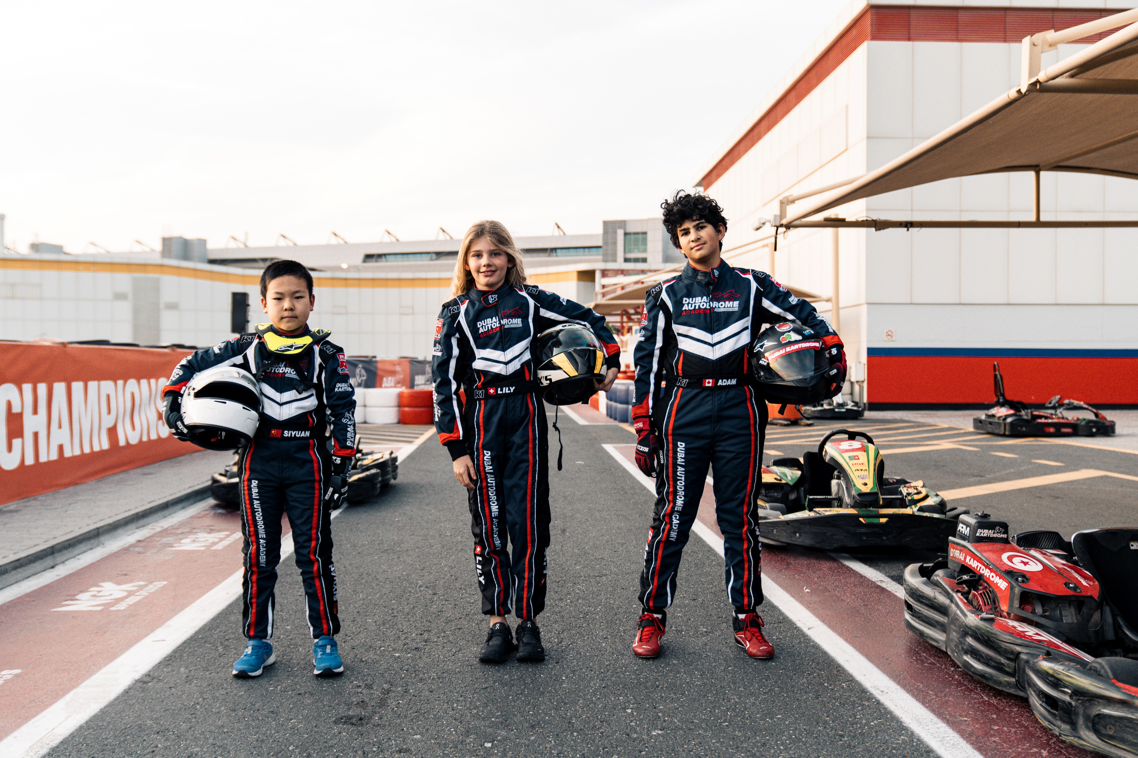
DAKA Race Suits
Now DAKA students & graduates have the chance to purchase a custom-made race suit!
Each suit will be made-to-measure, in CIK/FIA Spec and will be personalized with your name and country flag!
Please expect a 10-week turnaround from finalizing the order and measurements.
Avail this at a special price of AED 1,995! To order yours please contact purificacaop@dubaiautodrome.com
Suite Measurement Form

Slide 15
Dubai Kartdrome Terms & Conditions
These terms and conditions apply to all bookings of Dubai Autodrome experiences.
These terms and conditions replace any of our earlier terms and conditions in relation to our experiences, and no variation to these terms and conditions shall be binding unless agreed by Dubai Autodrome in writing. By booking with the Dubai Autodrome you agree on behalf of yourself and, if not yourself, the driver, to be bound by them in their entirety.
Requirements Indoor Circuit:
The minimum age to drive on the Indoor Circuit is 7 years (ID Required).
Driver height: Minimum height of 1m 25cm, to drive the Junior LR4 karts.
Age Group Juniors: 7 years till 12 years old are provided with Junior Sodi LR4 karts.
Age Group Seniors: 13 years and over are provided with Senior Sodi RX7/RX8 karts.
Race overalls, gloves covering fingers and thumbs and a full-face helmet must be worn at all times. These are provided by Dubai Kartdrome
Clear helmet visors only to be worn whilst driving on the Indoor Circuit.
Closed-toe shoes must be worn (Drivers are responsible for their own footwear and no sandals allowed).
Long hair must be tied and placed entirely in the balaclava inside the helmet, or tucked inside the back of the race suit.
Sign the disclaimer (Drivers below 18 years of age require a Parent/Legal Guardian to sign them in).
Driver’s must produce valid ID when registering (Emirates ID, Passport, Driving License).
Requirements Outdoor Circuit:
– Junior Karts are mandatory for drivers under 13 years of age.
– Drivers whom wish to drive with senior karts on the Outdoor Circuit, must be 13 years old and over (ID Required).
– Driver Height: Minimum height of 1m 57m, to drive the Senior Sodi RX7/RX8.
– Maximum weight is 135kg.
– Race overalls, gloves covering fingers and thumbs and a full-face helmet must be worn at all times.
– Clear helmet visors only to be worn after sunset.
– Closed-toe shoes must be worn (Drivers are responsible for their own footwear and no sandals allowed).
- Long hair must be tied and placed entirely in the balaclava inside the helmet, or tucked inside the back of the race suit.
– Sign the disclaimer (Drivers below 18 years of age require a Parent/Legal Guardian to sign them in).
– Driver’s must produce valid ID when registering (Emirates ID, Passport, Driving License).

Slide 16
Dubai Kartdrome Terms & Conditions
Conditions
You agree on behalf of yourself and the driver to observe all circuit/track rules and regulations and all instructions given by Dubai Autodrome, including our Kartdrome coordinators.
You agree on behalf of yourself and the driver to observe and comply with any advice, instruction, request or decision made by us whether on the grounds of the safety of the driver or any other person or for any other reason at all.
You agree on behalf of yourself and the driver that our opinion on all matters regarding safety will be final.
You agree on behalf of yourself and the driver that any driver acting in a manner which, in our opinion, is dangerous or may interfere with or disrupt the experience, we will at our sole discretion and without further liability to us immediately have the experience terminated without refund.
The driver must not have consumed any alcohol prior to the experience and we will be entitled at the time for any experience to prevent a driver from driving who, in our opinion, may have consumed alcohol beforehand.
No driver will be allowed to take part in any experience unless they have attended the full safety briefing preceding the experience.
Where required by Dubai Autodrome all drivers, without exception, must wear their own or the provided crash helmet, race suit, gloves and suitable sports shoes (no sandals allowed).
Cancellation and Refunds
No refunds of the price will be payable by Dubai Autodrome.
We reserve the right to cancel an experience due to adverse weather conditions that may affect your safety. We cannot be held liable for any costs incurred in this circumstance.
You will be entitled to use an alternative experience session no more than three months after the initial cancelled experience.
Social Media
By entering this venue, you are agreeing that should any digital content (images or videos) be generated by Dubai Autodrome or accredited Dubai Autodrome Photographers or videographers, Dubai Autodrome incurs the right to use this content for promotional use.
Dubai Autodrome will always ask the user permission before publishing user generated content.

Slide 17
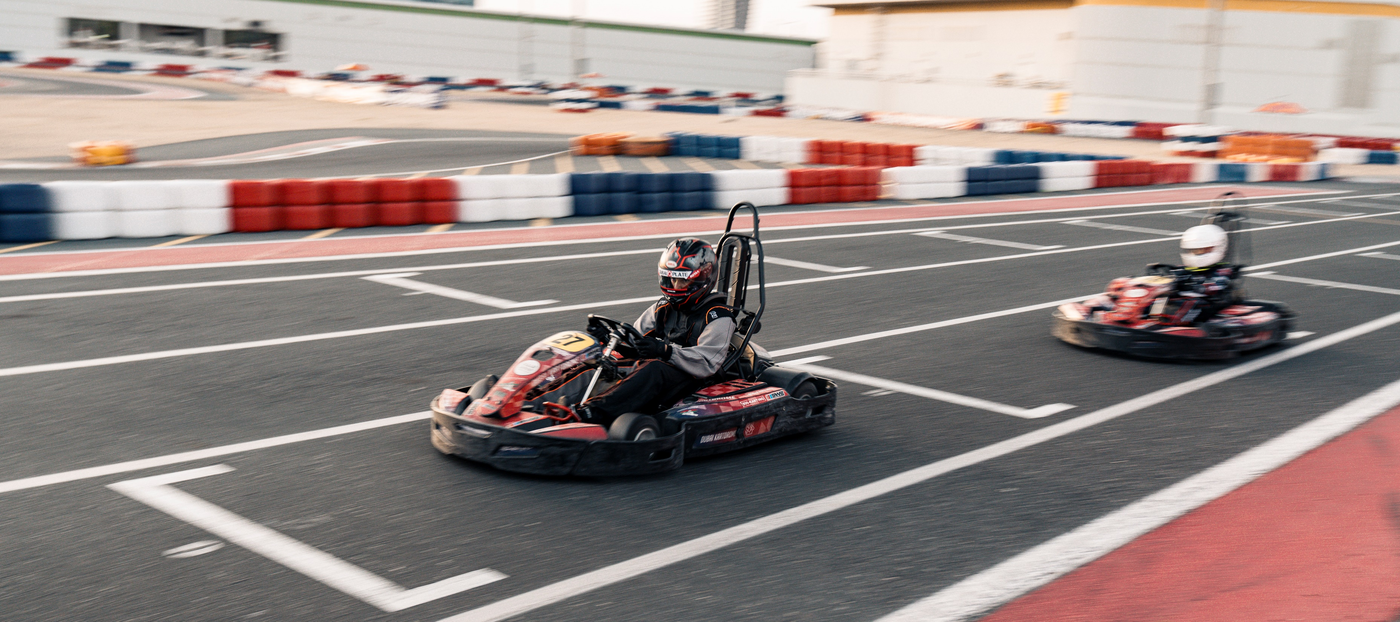
What else can you do at the Kartdrome?
Ironman Open Practice Sessions every Wednesday
Our weekly 'Ironman’ 45-minute open practice sessions are a great way for kids to burn calories, keep race fit and provides enough track time to practice what they have learnt at DAKA. DAKA students have a discount on Ironman sessions during the term.
A DAKA Discount is available on all ironman Junior Products, Contact vaalb@dubaiautodrome.com for more information.
SWS – SODI WORLD SERIES – You are now eligible to race!
The world’s most popular and famous leisure kart racing series! We provide the kart, racing suit, helmet and gloves. You provide the racing spirit! No need to do anything other than book well in advance. We have two races per month, and we use unique track layouts for each event which keeps things interesting.
All SWS Championship points go towards their National & World rankings, where the top drivers each year get selected to participate at the World Leisure kart finals. SODI WORLD SERIES

Slide 18
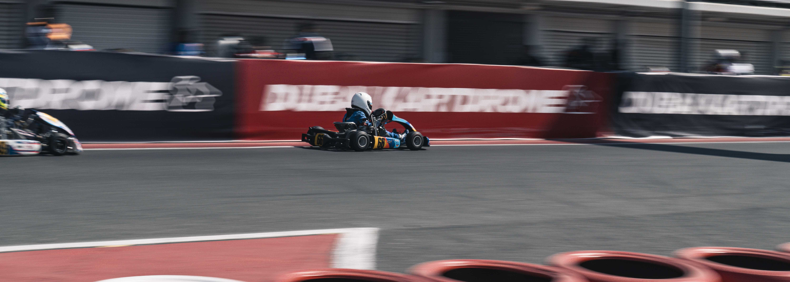
What else can you do at the Kartdrome?
Buying a kart, Storage and Membership
If you’re interested in buying a Kart, which means you can practice 7 days a week here at Dubai Kartdrome and take part in the National Races as well. We have a wide range of services available for kart owners, including:
A World Class Storage Facility so you can safely store your kart in a secure environment
A wide range of membership options available to suit all budgets
1 to 1 tuition available
A Pro Shop on site for all your karting needs
If you’re looking to buy a kart, we have teams based on site selling new karts. We also have available a list of members selling used karts at affordable prices. Please contact davidb@dubaiautodrome.com for more information and advice on making a kart purchase.
Birthday Parties
Come and celebrate your special day at the Indoor Kartdrome with all your friends including Karting, laser tag and racing simulators. Please contact karting@dubaiautodrome.com for more information.

